Slide 1
META - DES

Slide 2
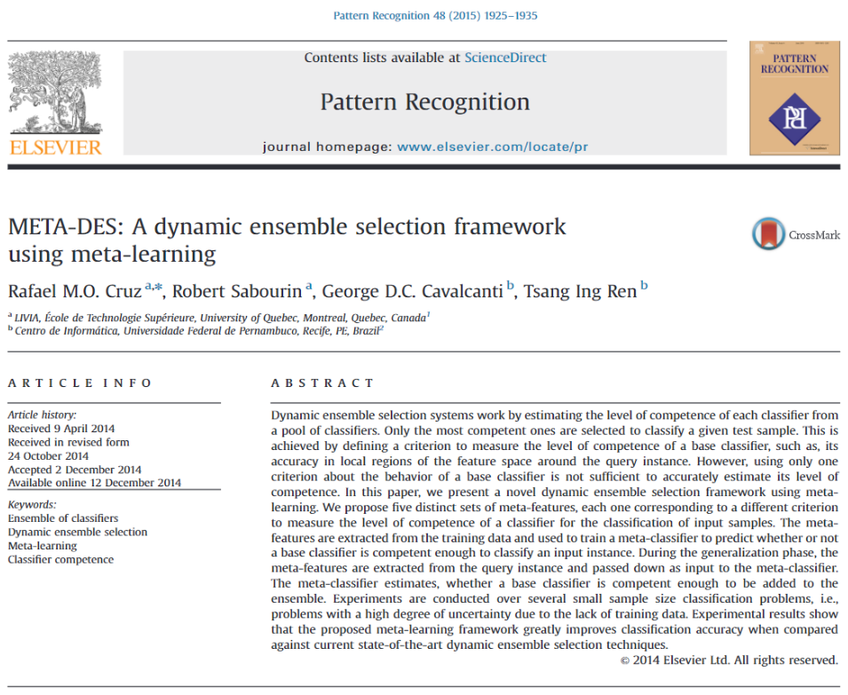
기존 DES에서의 문제:
KNORA같은 경우,
한 test point에 대해서 K개 validation point 뽑은 후,
{그 valid point를 맞게 predict한 classifier들}을 모아보니,
{그 classifier들}은 그 test point에 대해
[1, 1, 1, 0, 0, 0] 혹은 [1, 1, 1, 1, 0, 0]과 같이 predict
-> consensus가 낮은 경우가 문제이므로,
이를 해결하기 위해 META-DES 고안

Slide 3
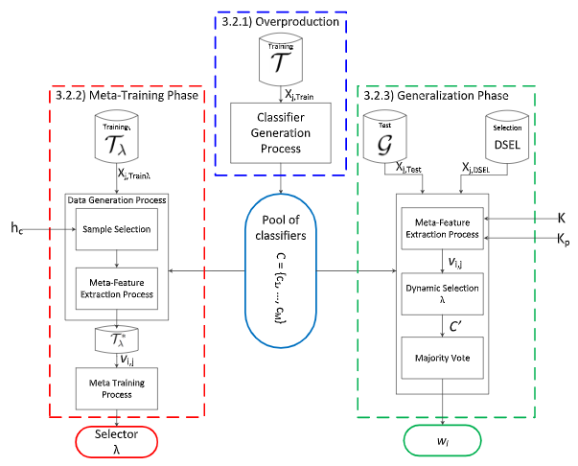

Slide 4
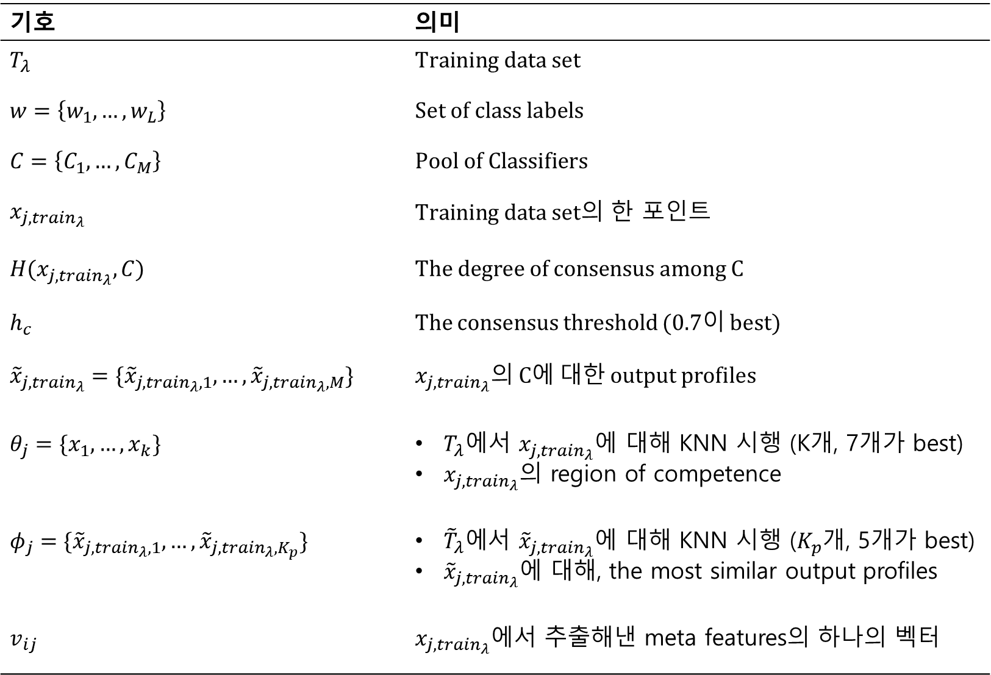
기호 | 의미
$$T_{λ}$$ | $$Training data set$$
$$w=\left\{w_{1}, …,w_{L}\right\}$$ | $$Set of class labels$$
$$C=\left\{C_{1}, …,C_{M}\right\}$$ | $$Pool of Classifiers$$
$$x_{j,{train}_{λ}}$$ | $Training data set의$ 한 포인트
$$H(x_{j,{train}_{λ}}, C)$$ | $$\text{The} \text{degree} \text{of} \text{consensus} \text{among} \text{C}$$
$$h_{c}$$ | The consensus threshold (0.7이 best)
$${\tilde{x}}_{j,{train}_{λ}}=\{{\tilde{x}}_{j,{train}_{λ}, 1}, …,{\tilde{x}}_{j,{train}_{λ}, M}\}$$ | $x_{j,{train}_{λ}}$의 C에 대한 output profiles
$$θ_{j}=\{x_{1}, …,x_{k}\}$$ | $T_{λ}$에서 $x_{j,{train}_{λ}}$에 대해 KNN 시행 (K개, 7개가 best) $x_{j,{train}_{λ}}$의 region of competence
$$φ_{j}=\{{\tilde{x}}_{j,{train}_{λ}, 1}, …,{\tilde{x}}_{j,{train}_{λ}, K_{p}}\}$$ | ${\tilde{T}}_{λ}에$서 ${\tilde{x}}_{j,{train}_{λ}}$에 대해 KNN 시행 ($K_{p}$개, 5개가 best) ${\tilde{x}}_{j,{train}_{λ}}$에 대해, the most similar output profiles
$$v_{ij}$$ | $x_{j,{train}_{λ}}$에서 추출해낸 meta features의 하나의 벡터

Slide 5






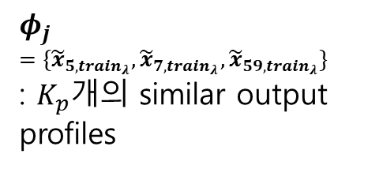


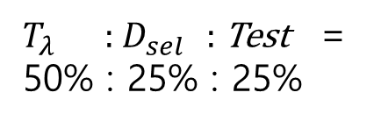
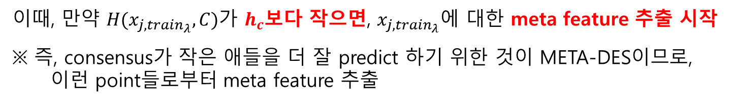



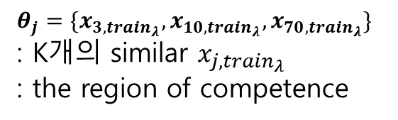




$$C=\left\{C_{1}, …, C_{M}\right\}$$
$T_{λ}$ : $D_{sel }$ : Test =
50% : 25% : 25%
$$T_{λ}$$
$$x_{3,{train}_{λ}}$$
$$x_{5,{train}_{λ}}$$
1, 1 , 0, … , 0, 0, 0
: ${\tilde{x}}_{5,{train}_{λ}}$
$$x_{7,{train}_{λ}}$$
1, 1 , 1, … , 0, 0, 1
: ${\tilde{x}}_{7,{train}_{λ}}$
$$x_{10,{train}_{λ}}$$
: ${\tilde{x}}_{j,{train}_{λ}}$
$$φ_{j}$$
$$=\{{\tilde{x}}_{5,{train}_{λ}},{\tilde{x}}_{7,{train}_{λ}}, {\tilde{x}}_{59,{train}_{λ}}\}$$
: $K_{p}개$의 similar output profiles
$$x_{j,{train}_{λ}}$$
1, 1 , 1, … , 0, 0, 0
$θ_{j}=\{x_{3,{train}_{λ}},x_{10,{train}_{λ}},x_{70,{train}_{λ}}\}$
: K개의 similar $x_{j,{train}_{λ}}$
: the region of competence
$:{ x}_{j,{train}_{λ}}$의 output profile
$$x_{59,{train}_{λ}}$$
1, 1 , 1, … , 0, 0, 1
: ${\tilde{x}}_{59,{train}_{λ}}$
$$x_{70,{train}_{λ}}$$
$$D_{sel }$$
Test
이때, 만약 $H(x_{j,{train}_{λ}}, C)$가 $h_{c}$보다 작으면, $x_{j,{train}_{λ}}$에 대한 meta feature 추출 시작
※ 즉, consensus가 작은 애들을 더 잘 predict 하기 위한 것이 META-DES이므로,
이런 point들로부터 meta feature 추출
$x_{j,{train}_{λ}} ,$ $C=\left\{C_{1}, …,C_{M}\right\}$, $θ_{j}=\left\{x_{3,{train}_{λ}},x_{10,{train}_{λ}},x_{70,{train}_{λ}}\right\}, φ_{j}=\left\{{\tilde{x}}_{5,{train}_{λ}},{\tilde{x}}_{7,{train}_{λ}}, {\tilde{x}}_{59,{train}_{λ}}\right\}$
-> meta feature $v_{ij}$ 추출 시작

Slide 6
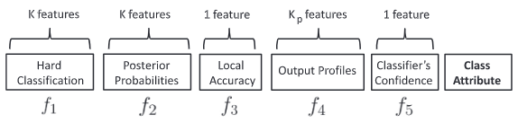




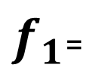
$x_{j,{train}_{λ}} ,$ $C=\left\{C_{1}, …,C_{M}\right\}$, $θ_{j}=\left\{x_{3,{train}_{λ}},x_{10,{train}_{λ}},x_{70,{train}_{λ}}\right\}, φ_{j}=\left\{{\tilde{x}}_{5,{train}_{λ}},{\tilde{x}}_{7,{train}_{λ}}, {\tilde{x}}_{59,{train}_{λ}}\right\}$
-> meta feature $v_{ij}$ 추출
K features
$$θ_{j}=\left\{x_{3,{train}_{λ}},x_{10,{train}_{λ}},x_{70,{train}_{λ}}\right\}$$
$$C_{1}$$
1 1 0
$$C$$
…
…
…
$f_{1}$=
1 0 0
…
…
…
$$C_{M}$$
0 1 0

Slide 7
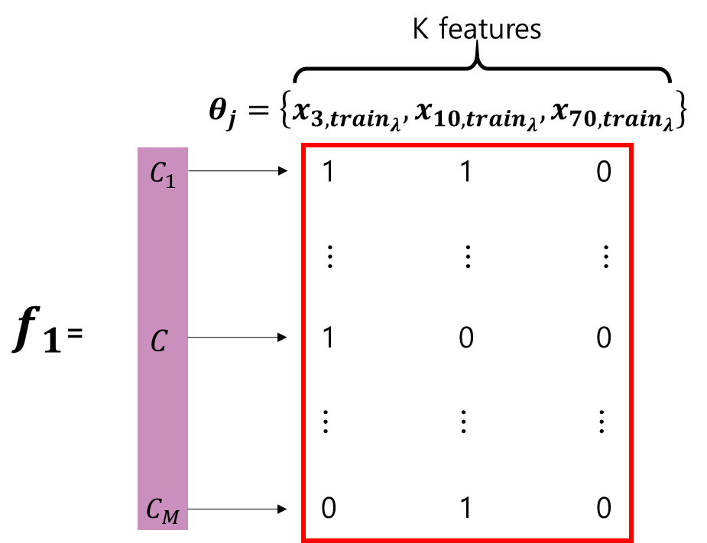


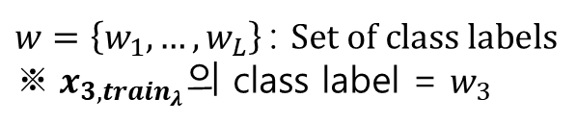


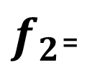
$x_{j,{train}_{λ}} ,$ $C=\left\{C_{1}, …,C_{M}\right\}$, $θ_{j}=\left\{x_{3,{train}_{λ}},x_{10,{train}_{λ}},x_{70,{train}_{λ}}\right\}, φ_{j}=\left\{{\tilde{x}}_{5,{train}_{λ}},{\tilde{x}}_{7,{train}_{λ}}, {\tilde{x}}_{59,{train}_{λ}}\right\}$
-> meta feature $v_{ij}$ 추출
K features
$$θ_{j}=\left\{x_{3,{train}_{λ}},{ x}_{10,{train}_{λ}},{ x}_{70,{train}_{λ}}\right\}$$
$$C_{1}$$
$P(w_{3}│x_{3,{train}_{λ}})$ $P(w_{10}│x_{10,{train}_{λ}})$ $P(w_{70}│x_{70,{train}_{λ}})$
$$C$$
…
…
…
$f_{2}$=
$P(w_{3}│x_{3,{train}_{λ}})$ $P(w_{10}│x_{10,{train}_{λ}})$ $P(w_{70}│x_{70,{train}_{λ}})$
$w=\left\{w_{1}, …,w_{L}\right\}$: $Set of class labels$
${※ x}_{3,{train}_{λ}}의$ class label = $w_{3}$
…
…
…
$ex) C1, C,C_{M}이 있다면, C_{1}에 대해, P\left(w_{3} | x_{3,{train}_{λ}}\right)=\frac{2}{3}$
$$C_{M}$$
$P(w_{3}│x_{3,{train}_{λ}})$ $P(w_{10}│x_{10,{train}_{λ}})$ $P(w_{70}│x_{70,{train}_{λ}})$

Slide 8







$x_{j,{train}_{λ}} ,$ $C=\left\{C_{1}, …,C_{M}\right\}$, $θ_{j}=\left\{x_{3,{train}_{λ}},x_{10,{train}_{λ}},x_{70,{train}_{λ}}\right\}, φ_{j}=\left\{{\tilde{x}}_{5,{train}_{λ}},{\tilde{x}}_{7,{train}_{λ}}, {\tilde{x}}_{59,{train}_{λ}}\right\}$
-> meta feature $v_{ij}$ 추출
1 features
$$0.95$$
$$C_{1}$$
$$0.80$$
$$C$$
$f_{3}$=
$$C_{M}$$
$$0.79$$

Slide 9
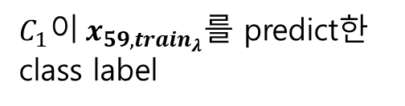




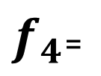

$x_{j,{train}_{λ}} ,$ $C=\left\{C_{1}, …,C_{M}\right\}$, $θ_{j}=\left\{x_{3,{train}_{λ}},x_{10,{train}_{λ}},x_{70,{train}_{λ}}\right\}, φ_{j}=\left\{{\tilde{x}}_{5,{train}_{λ}},{\tilde{x}}_{7,{train}_{λ}}, {\tilde{x}}_{59,{train}_{λ}}\right\}$
-> meta feature $v_{ij}$ 추출
$K_{p}$ features
$$φ_{j}=\left\{{\tilde{x}}_{5,{train}_{λ}},{\tilde{x}}_{7,{train}_{λ}}, {\tilde{x}}_{59,{train}_{λ}}\right\}$$
$$C_{1}$$
$w_{1,5}$ $w_{1,7}$ ${ w}_{1,59}$
$C_{1}이 x_{59,{train}_{λ}}를$ predict한 class label
$$C$$
…
…
…
$f_{4}$=
$w_{j,5}$ $w_{j,7}$ ${ w}_{j,59}$
…
…
…
$$C_{M}$$
$w_{M,5}$ $w_{M,7}$ ${ w}_{M,59}$

Slide 10
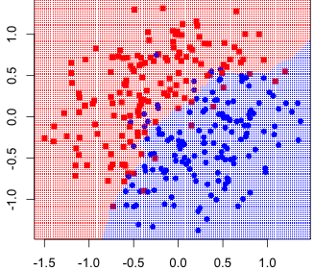
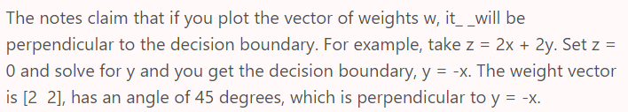


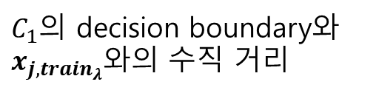





$x_{j,{train}_{λ}} ,$ $C=\left\{C_{1}, …,C_{M}\right\}$, $θ_{j}=\left\{x_{3,{train}_{λ}},x_{10,{train}_{λ}},x_{70,{train}_{λ}}\right\}, φ_{j}=\left\{{\tilde{x}}_{5,{train}_{λ}},{\tilde{x}}_{7,{train}_{λ}}, {\tilde{x}}_{59,{train}_{λ}}\right\}$
-> meta feature $v_{ij}$ 추출
1 features
$$1.12$$
$C_{1}$의 decision boundary와 $x_{j,{train}_{λ}}$와의 수직 거리
$$C_{1}$$
$$3.50$$
$$C$$
$f_{5}$=
: dot product
$$C_{M}$$
$$0.02$$

Slide 11







$x_{j,{train}_{λ}} ,$ $C=\left\{C_{1}, …,C_{M}\right\}$, $θ_{j}=\left\{x_{3,{train}_{λ}},x_{10,{train}_{λ}},x_{70,{train}_{λ}}\right\}, φ_{j}=\left\{{\tilde{x}}_{5,{train}_{λ}},{\tilde{x}}_{7,{train}_{λ}}, {\tilde{x}}_{59,{train}_{λ}}\right\}$
-> meta feature $v_{ij}$ 추출
1 features
$$0$$
$$C_{1}$$
$$1$$
$C_{1}이 x_{j,{train}_{λ}}$를 맞게 predict했으면 1
$$C$$
Class
Attribute =
$$C_{M}$$
$$1$$

Slide 12
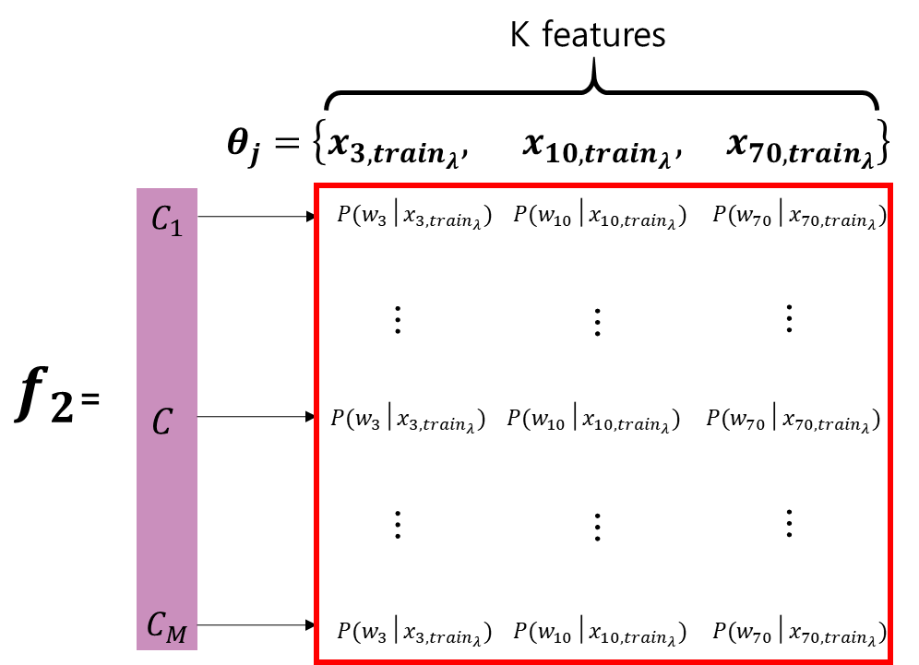
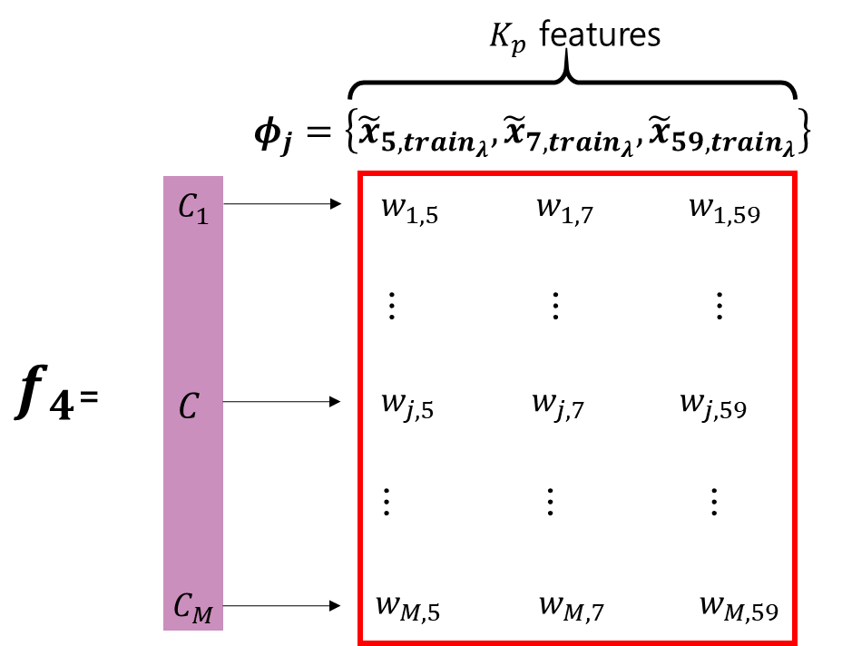
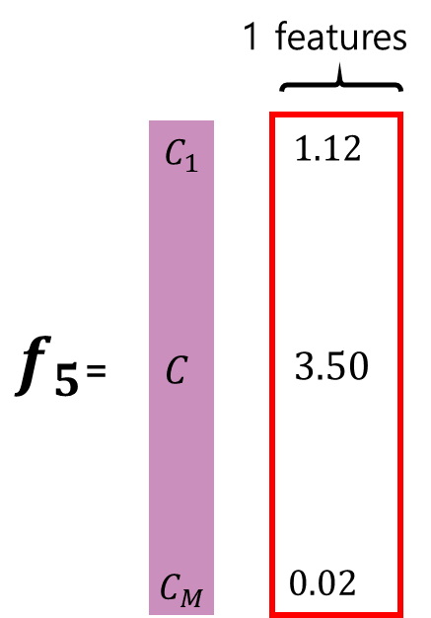
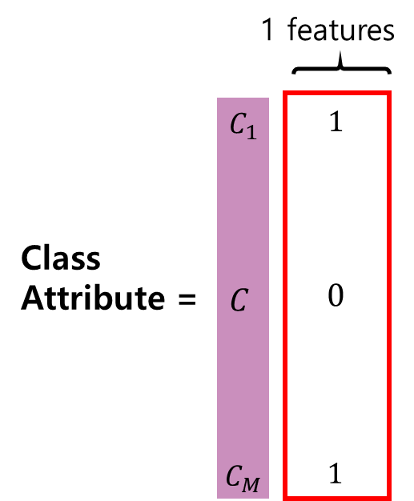
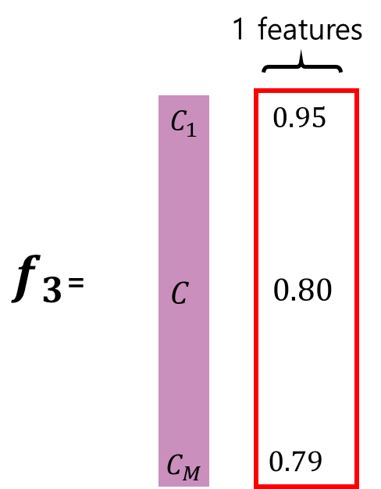

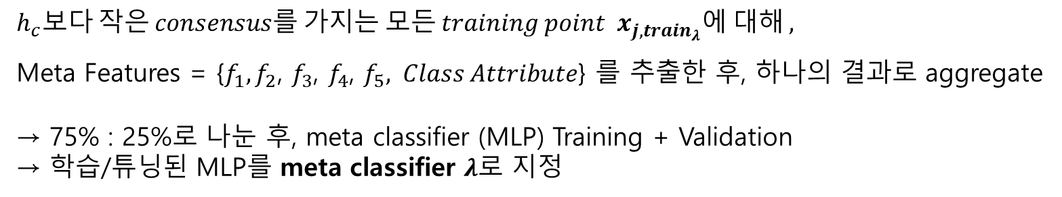
$x_{j,{train}_{λ}}$의 Meta Features :
$$h_{c}보다 작은 consensus를 가지는 모든 training point x_{j,{train}_{λ}}에 대해 ,$$
Meta Features = {${f_{1}, f}_{2}$, $f_{3}$, $f_{4}$, $f_{5}, Class Attribute$} 를 추출한 후, 하나의 결과로 aggregate
→ 75% : 25%로 나눈 후, meta classifier (MLP) Training + Validation
→ 학습/튜닝된 MLP를 meta classifier $λ$로 지정

Slide 13




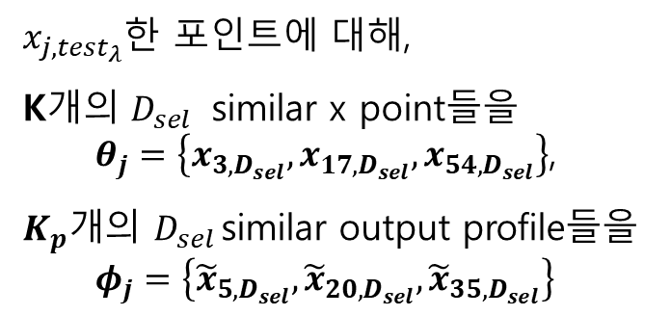

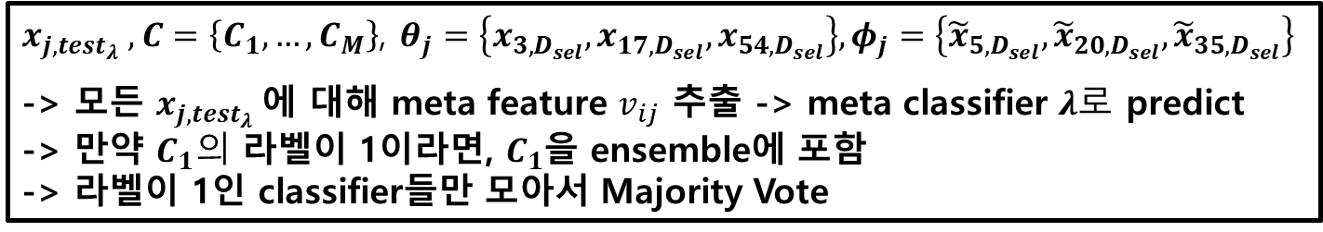


$$C=\left\{C_{1}, …, C_{M}\right\}$$
$$T_{λ}$$
$$D_{sel }$$
$$x_{3,D_{sel}}$$
1, 0 , 0, … , 0, 0, 0
: ${\tilde{x}}_{3,D_{sel}}$
Test
$$x_{16,{test}_{λ}}$$
1, 1 , 0, … , 0, 0, 0
: ${\tilde{x}}_{16,{test}_{λ}}$
$x_{j,{test}_{λ}}$한 포인트에 대해,
K개의 $D_{sel }$ similar x point들을
$θ_{j}=\left\{x_{3,D_{sel}},x_{17,D_{sel}},x_{54,D_{sel}}\right\}$,
$K_{p}개$의 $D_{sel }$similar output profile들을
$$φ_{j}=\left\{{\tilde{x}}_{5,D_{sel}},{\tilde{x}}_{20,D_{sel}}, {\tilde{x}}_{35,D_{sel}}\right\}$$
$x_{j,{test}_{λ}} ,$ $C=\left\{C_{1}, …,C_{M}\right\}$, $θ_{j}=\left\{x_{3,D_{sel}},x_{17,D_{sel}},x_{54,D_{sel}}\right\}, φ_{j}=\left\{{\tilde{x}}_{5,D_{sel}},{\tilde{x}}_{20,D_{sel}}, {\tilde{x}}_{35,D_{sel}}\right\}$
-> 모든 $x_{j,{test}_{λ}}$에 대해 meta feature $v_{ij}$ 추출 -> meta classifier $λ로$ predict
-> 만약 $C_{1}의$ 라벨이 1이라면, $C_{1}$을 ensemble에 포함
-> 라벨이 1인 classifier들만 모아서 Majority Vote

Slide 14





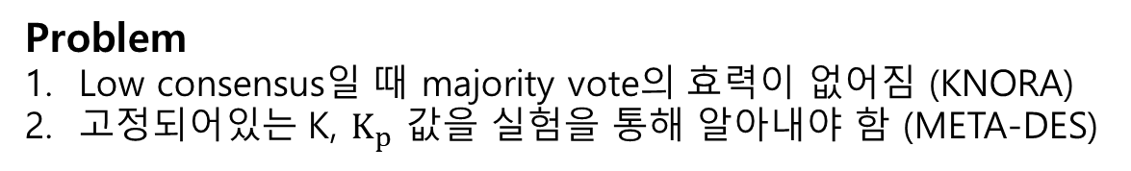
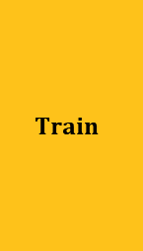









Future Works
Problem
Low consensus일 때 majority vote의 효력이 없어짐 (KNORA)
고정되어있는 K, $K_{p}$ 값을 실험을 통해 알아내야 함 (META-DES)
$$X_{j2}$$
$$Train$$
$$x_{1,val}$$
$$x_{20,val}$$
: $one point of Test set$
$$x_{10,val}$$
$$x_{9,val}$$
$$:Validation Point$$
$$x_{60,val}$$
r
$$Val$$
$$x_{k,test}$$
$$x_{35,val}$$
$$x_{k,test}$$
$$x_{41,val}$$
Test
$$X_{j1}$$
K값이 정해져 있는 KNN이 아닌,
반경 안에 있는 validation point에 대해서 dynamic ensemble selection

Slide 15











$$X_{j2}$$
$$x_{20,val}$$
: $x_{k,test}=one point of Test set$
$$R_{2}$$
$$x_{9,val}$$
$$:λ= Validation Point within Radius$$
$$x_{60,val}$$
$$R_{1}$$
$$x_{k,test}$$
: $Validation Point$
$$x_{35,val}$$
$$x_{41,val}$$
$$X_{j1}$$

Slide 16

Future Works

